Slide 1
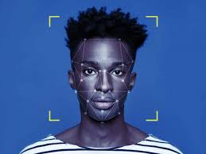
EMOTION DETECTION

Slide 2
TEAM SUPERVISOR:
TEAM LEADER:
MS. DIVYA SINGHAL
TEAM MEMBERS:
SACHIN LAL
MUSKAN CHOUDHARY
AVNI TYAGI
VIDUSHI SHUKHLA
!

Slide 3
INTRODUCTION
Our Emotion recognition software, will works by detecting a face within a live video stream or an image.
Once a face has been detected, the software analyzes the position and movement of the facial muscles in order to determine the individuals sentiment.
The technology will then output a confidence score for every detected emotion together with a time stamp, making it easy to match the responses to content that has been showed.

Slide 4
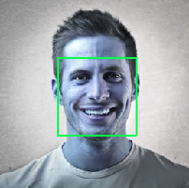
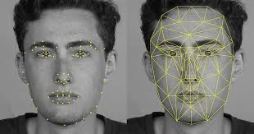
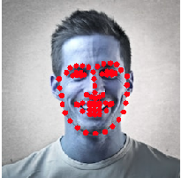
THREE MAIN COMPONENTS:
POWERPOINT
CANVA
IMAGE PROCESSING
FEATURE EXTRACTION
FEATURE CLASSIFICATION

Slide 5
PROCESS:
1.
2.
1.INPUT IMAGE
2. FACE DETECTION
3. FACIAL LANDMARKS.
4. DETECT EMOTION
The first step will be to input image or face either by camera or from image.
Facial detection is an important step in emotion detection. It removes the parts of the image that aren’t relevant.
Facial landmarks are a set of key points on human face images. The points are defined by their (x,y) coordinates on the image. These points are used to locate and represent salient regions of the face, such as eyes, eyebrows, nose, mouth and jawline..
The last step would be to detect emotion

Slide 6
SOFTWARE REQUIREMENTS
Python 3 or above
Library - open cv,keras
Development and compatible tools used - Pycharm, Anaconda

Slide 7
HARDWARE REQUIREMENTS
Central Processing Unit (CPU) - Intel Core i5 6th gen or AMD processor equivalent.
RAM - 8 GB minimum, 16 GB or higher is recommended.
Graphics Processing Unit (GPU) - NVIDIA GeForce GTX960 or higher
Inbuilt Camera or Webcam Support
Operating System (OS) - Ubuntu or Microsoft Windows 10
Storage - 20 GB

Slide 8
MODULES DESCRIPTION:
This module consists of the data that we have used in the formation of this project or the system i.e., Emotion Recognition System.
The data set that we have used is the Keras data set.
Data set consist of various emotions with each picture consisting of specified emotion.
Using all this data collecting from the data set available in the Keras Data set, we have used in our Code as by implementing libraries to recognize the emotion of a person. 19

Slide 9
Different modules that we have used in this Recognition system
This module is used for stating the Recognition System window where a person is supposed to keep the face with required brightness and face
ACTIVE MODULE
DETECTING
MODULE
This module is used for detecting the face in the Recognition System window where a person is supposed to keep the face with required brightness and face.
This module is used for detecting the face in the Recognition System window where a person is supposed to keep the face with required brightness and face. After recognizing the face, it will present the emotions of the person, if he is happy, sad, angry, feared, confused, surprised etc.
EMOTIONS
MODULE
-This module is used for closing the window of the Recognition System, where a person was detecting his/her emotions
EXIT MODULE

Slide 10



Infographic Slides
OPTION 1
Presentations are communication tools.
OPTION 2
Presentations are communication tools.
OPTION 3
Presentations are communication tools.
Presentations are communication tools that can be used as demonstrations, lectures, speeches, reports, and more. It is mostly presented before an audience.

Slide 11
HOW THIS PROJECT WILL SERVE THE SOCIETY:
ONLINE ADMISSION AND INTERVIEWS
ANALYSIS FOR A/B CAMPAIGN TESTING
ONLINE EDUCATION
HEALTH CARE AND VIDEO GAME TESTING

Slide 12

THANKS FOR
WATCHING

